Slide 1
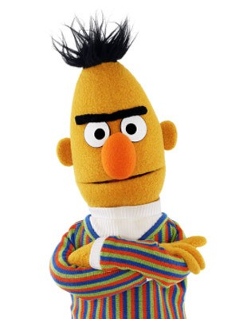
Introduction to Question Answering
DL4NLP Class

Slide 2
Table of Contents
Introduction to Question Answering (QA)
BERT for QA
Explainability in QA
SQuARE: Software for Question Answering Research

Slide 3
1. Introduction to QA

Slide 4
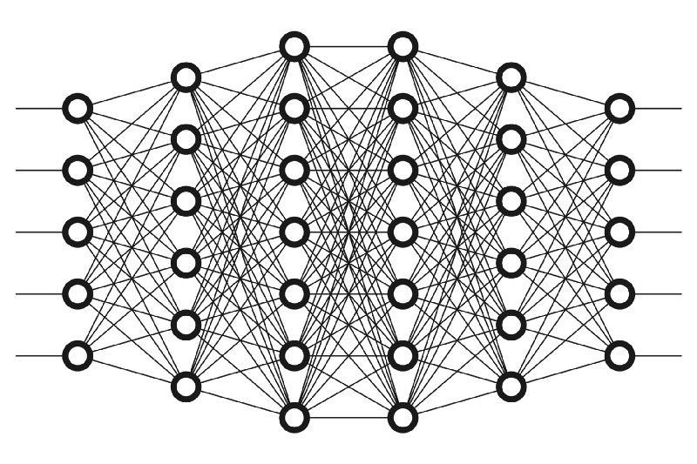
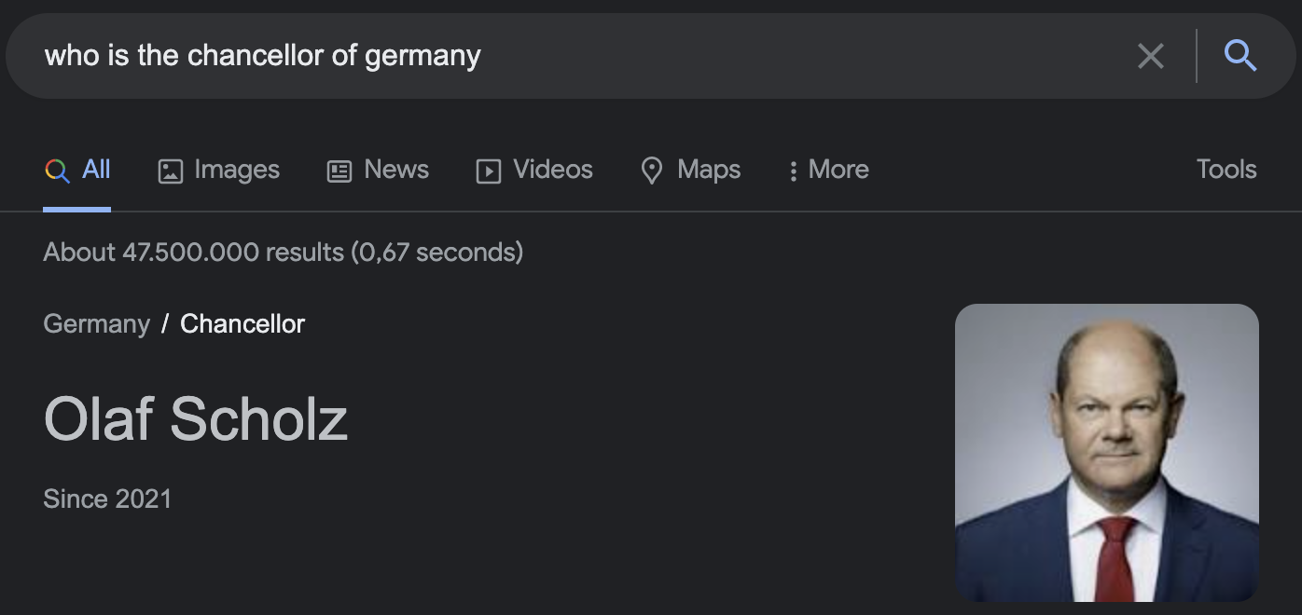
What is QA?
Question
Answer
Notes:
First of all, what is question answering? Well, it’s self-descriptive. It’s the NLP task of giving an answer to a question. We can easily see this in Google in some searchs. When we ask …., Google directly gives us the answer instead of just giving as a list of web pages.

Slide 5
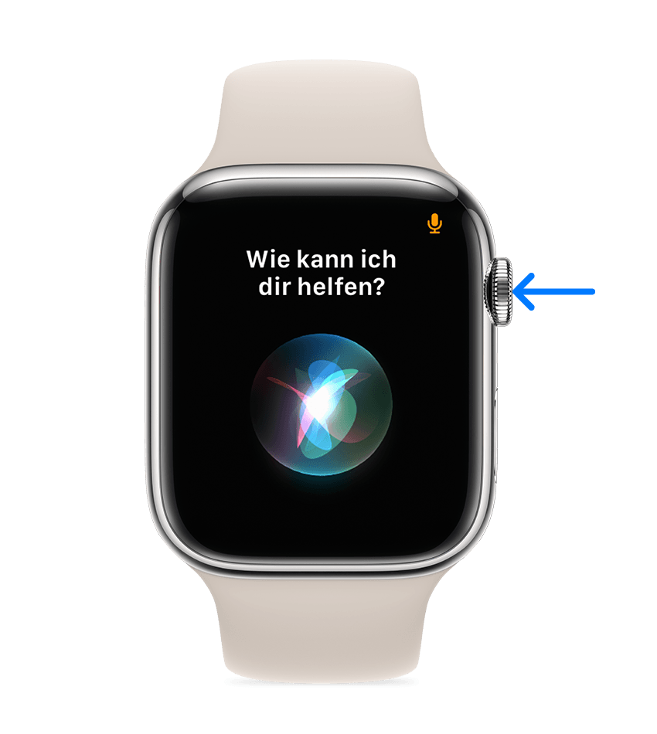
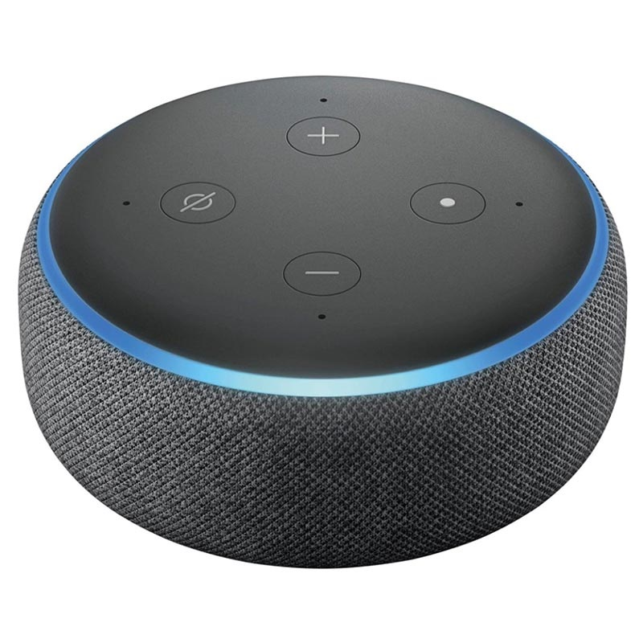
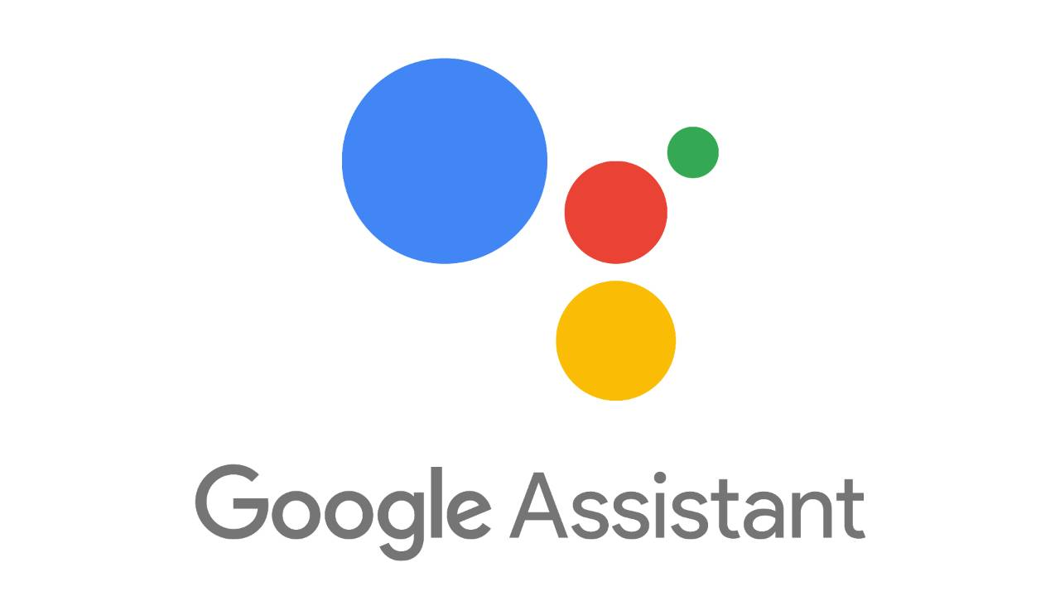

What is QA?
Notes:
QA is non only in Google Search. We can see QA everywhere, Siri, Alexa, Google Assistants, chatbots, etc

Slide 6
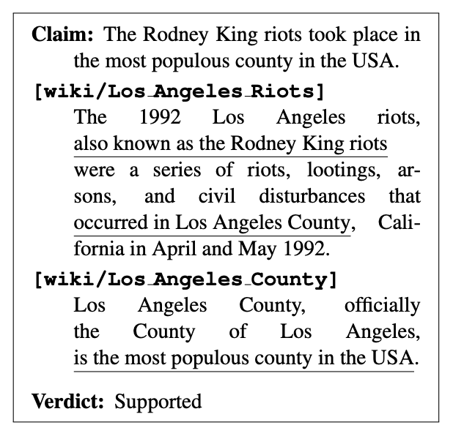

Why is QA important?
Ideal testbed to evaluate the natural language understanding of AI systems
Makes the knowledge of the world accessible
Many other NLP tasks can be modeled as QA
Fact Verification
Sentiment Analysis
The room was very comfortable.
Q: Is it true that the Rodney King riots took place in the most populous county in the USA?
Q: Is the sentiment positive?
Q: What is the sentiment?
FEVER: a Large-scale Dataset for Fact Extraction and VERification (Thorne et al., NAACL 2018)
Notes:
QA is very important in NLP because it is an interface to evaluate NLU in a human-friendly way. It’s easy for humans to build datasets and evaluate models. \\
It makes the knowledge of the world accessible. You can ask anything to google and you will get an answer.
Also, many other NLP tasks can be modeled as QA. Like Fact Verufucatubi and sentiment analysis.
In Fact verification we have a claim, some evidence, and we need to know if evidence supports the claim or not. The claim can be converted super easily into a question.
Similarly in sentiment analysis, we can always ask if the sentiment is positive. Of course, just a modeling as a classification task might be more appropriate, but this shows that QA is very flexible.

Slide 7
QA Types
Extractive QA (a.k.a. Machine Reading Question Answering)
Multiple-Choice QA
Open Domain QA (a.k.a. Open Retrieval)
Visual QA
And many others
Notes:
There are many types of QA settings. The most important ones are:
Let’s see them one by one

Slide 8
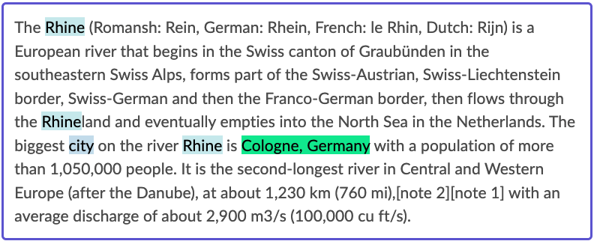
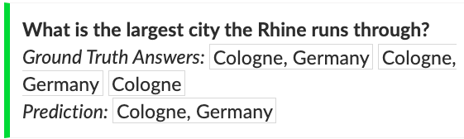
Extractive QA
(Question , Passage) → A
The answer is a contiguous span of the text
* The passage is sometimes called context
SQuAD: 100,000+ Questions for Machine Comprehension of Text (Rajpurkar et al., EMNLP 2016)
Notes:
In Extractive QA, the input is a passage and a question and the answer is span from the passage. In the example, the answer is in green.
Sometimes the passage is called context. You will see this on the internet.
This question comes from SQuAD, probably the most famous QA dataset.

Slide 9
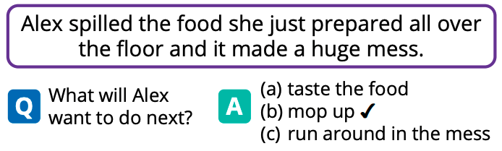
Multiple-Choice QA
(Question, Passage, Opt₁, …, Opt_{k}) → A
Social IQa: Commonsense Reasoning about Social Interactions (Sap et al., EMNLP 2019)
Notes:
In multiple choice QA, the input is the question, a passage, and a list of candidate answers. And the answer is one of these answers.
This question comes from the dataset Social iQA, which aims to evaluate common sense reasoning about social interactions.

Slide 10
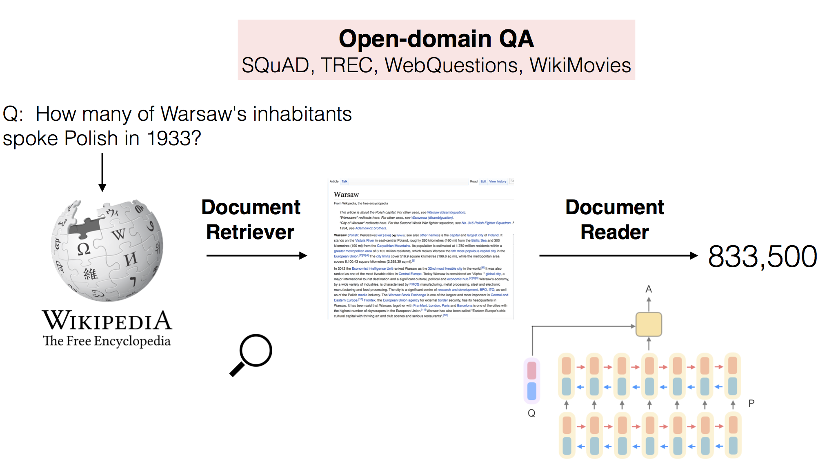
Open Domain Question Answering
Question → Answer
Reading Wikipedia to Answer Open-Domain Questions (Chen et al., ACL 2017)
Notes:
Another very popuar QA setup is Open Domain QA. Here the only input we have is the question.
The QA system has to retrieve a document that may contain the answer from a document collection like Wikipedia. Once it has a relevant document, it has to read it and extract the answer. This is known as the Retriever-Reader framework.

Slide 11
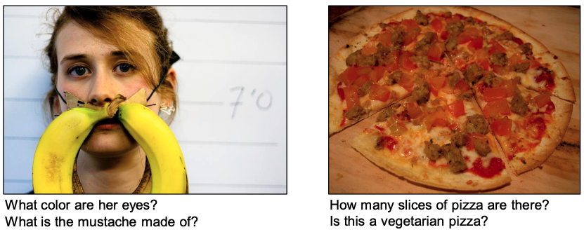
Visual QA
(Q, Img) → A
Notes:
Lastly, I wanna mention visual QA. Here we have a question and an image. To give the answer, we need to understand the image.

Slide 12
QA Datasets

Slide 13
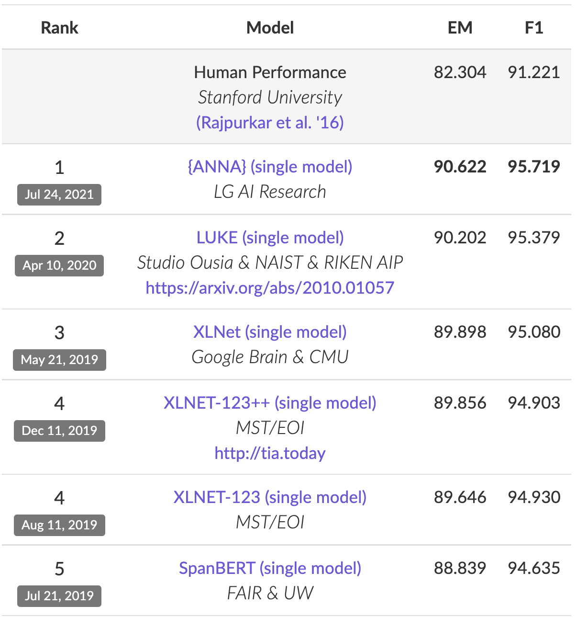
Stanford QA Dataset (SQuAD)
First large QA dataset (100k QA pairs)
Passages are from English Wikipedia (100-150 words)
Questions are crowd-sourced
Answers are spans in the passage
Current QA models have “super-human” performance!
Still one of the most popular QA datasets
SQuAD: 100,000+ Questions for Machine Comprehension of Text (Rajpurkar et al., EMNLP 2016)
Notes:
The most famous dataset is SQuAD. This is the first large QA dataset. It has 100K QA pairs.
All the passages are short paragraphs from Wikipedia and the questions are crowdsourced. This means that the people from Stanford recruited many random people from the internet to write questions about those paragraphs. So, the crowdworkers are not experts, and thus Stanford had to implement some quality measures to ensure that only good questions are accepted.
This is an screenshot of the leaderboard, and as you can see, some models are better than the ”Human performance”. This “Human Performance” was obtained by asking a set of people to answer the questions of the test set and get their average score. However, this does not mean that current QA is better than humans in general. It only shows that in SQuAD, QA models can do some tricks to get really high performance.

Slide 14
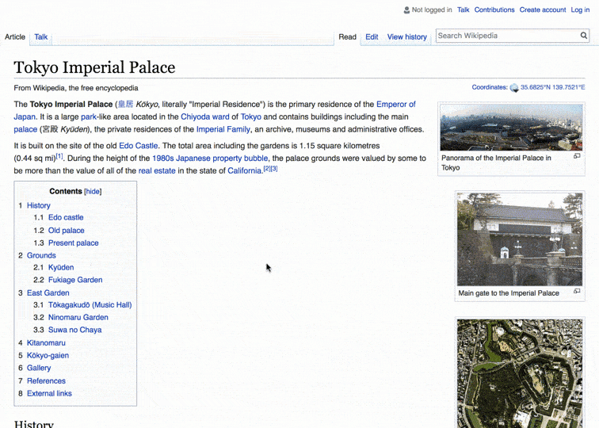
Popular Datasets: Natural Questions
Real questions in Google Search
The context is the first paragraph of Wikipedia
2 types of answers:
Long (find a paragraph)
Short (find the exact answer)
Natural Questions: A Benchmark for Question Answering Research (Kwiatkowski et al., TACL 2019)
Notes:
Another very popular dataset is Natural Questions. It was created by Google and aims to evaluate the ability of QA models to answers the questions of people on Google Search.
The questions are real questions in Google Search and the documents come from Wikipedia.
There are two types of answers:
Long: a paragraph that contains the answer
Short: the exact answer.
Does this sound familiar? (see next slide) (questions from google search, long answers, short answers…). I’ve seen this before… have you?

Slide 15
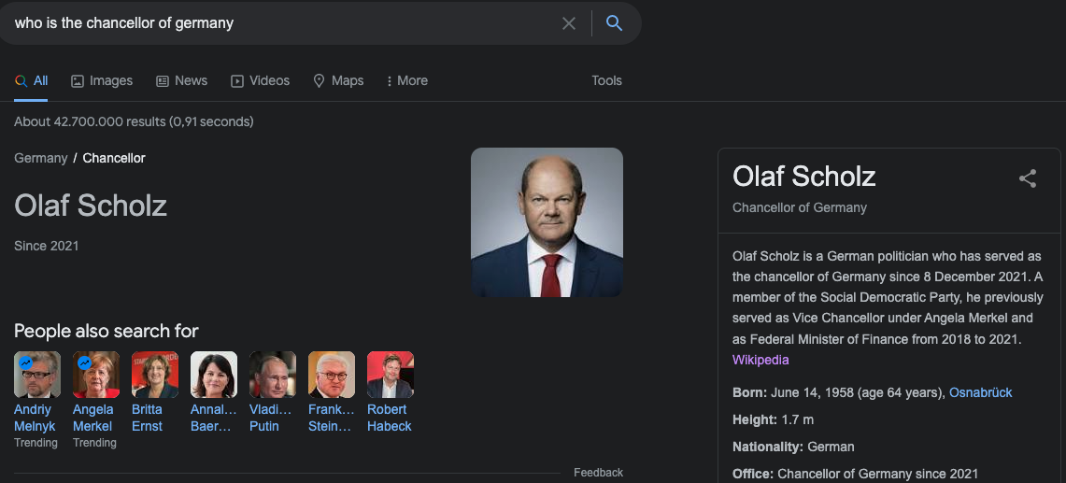
NQ Is What Google Is Doing!!
Notes:
This is what google is doing all the time. QA is super important in our lives, we use it continuously and after today, you will be able to create your own models!
QA has such a big impact in the society and being able to be part of it is super exciting! QA makes the knowledge of the world accessible.

Slide 16
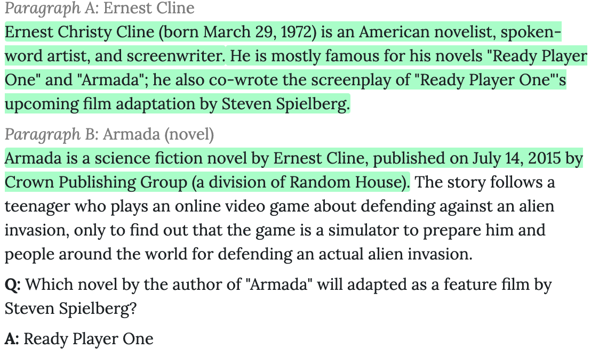
Popular Datasets: HotpotQA
HotpotQA: A Dataset for Diverse, Explainable Multi-hop Question Answering (Yang et al., EMNLP 2018)
Notes:
Another very popular dataset is HotpotQA (Spoiler: Google is also involved although they are not the main authors). If you wanna work in Google, maybe QA can help you XD
Anyway, In this dataset we want to evaluate the ability of the models to do multi-hop reasoning. So the model needs to read more than one paragraph to get the answer and it needs to connect them. \\
In this case
If we get the question and paragraph A alone, we cannot get the answer.

Slide 17
Popular QA Datasets
NewsQA:
CNN news as passages
Crowdsourced questions
DROP:
Numerical reasoning
Crowdsourced questions
TriviaQA:
Trivia questions
Passages from Bing search and Wikipedia
SearchQA:
Trivia questions from Jeopardy! TV show
Passages from Google Search
Notes:
There are many datasets. In our homework, we will use:
NewsQA which is about news
TriviaQA, which is about …
SearchQA, which is also about …
And finally, even though we are not using it on our homework, I also wanna mention DROP.

Slide 18
2. BERT for Question Answering
Notes:
Okay, let’s go a bit more technical. How can we use BERT for QA

Slide 19
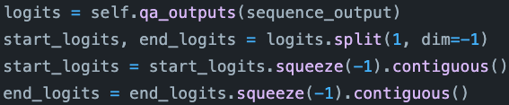
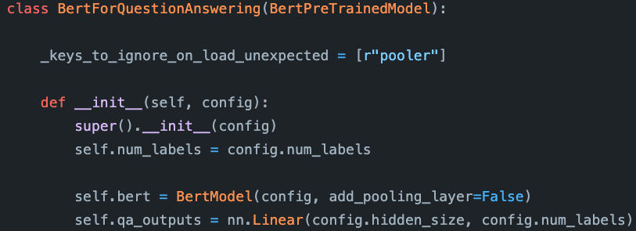
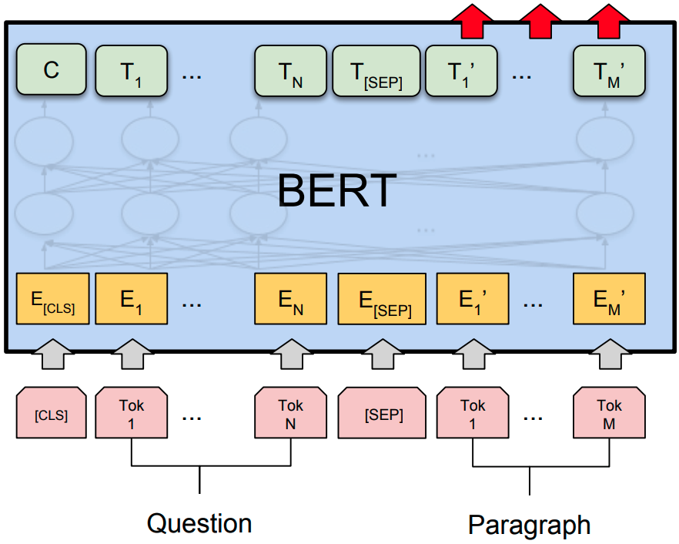
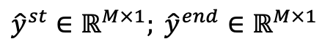
BERT for QA
${\hat{y}}^{st}∈ℝ^{M×1}; {\hat{y}}^{end}$ $∈ℝ^{M×1}$
qa_outputs
2
https://github.com/huggingface/transformers/blob/v4.19.4/src/transformers/models/bert/modeling_bert.py
BERT: Pre-training of Deep Bidirectional Transformers for Language Understanding (Devlin et al., NAACL 2019)
Notes:
We all know BERT already. A Transformer model trained on thousands of documents.\\
For QA, the input is the question and the context. And they are separted by the [SEP] token. \\
This is implemented like this: BERTModel and a linear layer for the QA head. (Show animation) \\
So we have to fine-tune this model, and train the head, so what is the output? \\
The output is a vector of size Mx2 (M is the number of tokens). 1 for starting and 1 for ending indexes. We need to split it to get the start_logits and the end_logits
So the qa_outputs layer will predict the probability that a token is the starting index of the answer and the ending index of the answer.

Slide 20
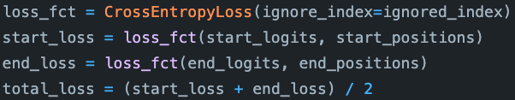
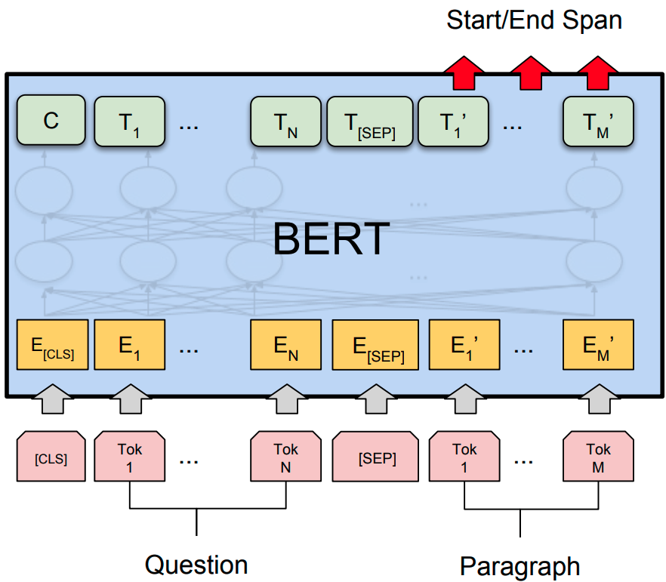
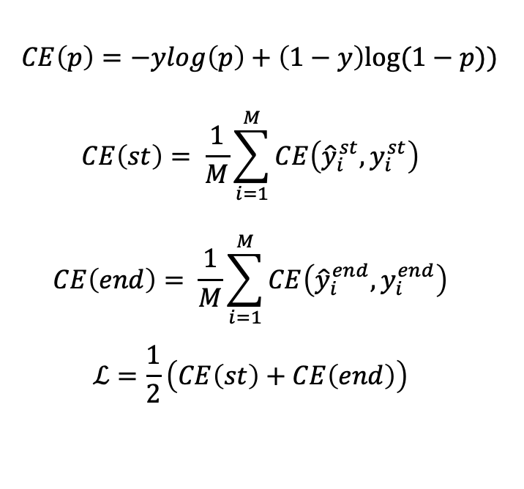
Training
Predictions for the starting span
Labels for the starting span
$$CE\left(p\right)=−ylog\left(p\right)+\left(1−y\right)log⁡(1−p))$$
$$CE\left(st\right)= \frac{1}{M}\sum_{i=1}^{M}{CE\left({\hat{y}}_{i}^{st}, y_{i}^{st}\right)}$$
$$CE\left(end\right)= \frac{1}{M}\sum_{i=1}^{M}{CE\left({\hat{y}}_{i}^{end}, y_{i}^{end}\right)}$$
$$ℒ=\frac{1}{2}\left(CE\left(st\right)+CE\left(end\right)\right)$$
Notes:
Once we understand the output, the training is very easy. Just four lines of code . It’s just the cross-entropy of the starting logits and the ending logits. We compute their average and done. \\
Now, let’s see this mathematically.
The first equation is the equation is just the Cross-Entropy used in physics, chemistry, cryptography, and ofc, Machine Learning. \\
So we need to compute the CE of the starting index prediction. (line 2 in code) \\
This is the prediction of the starting span and this is the label for the starting span
Same with the ending token.
And finally, we compute the average

Slide 21
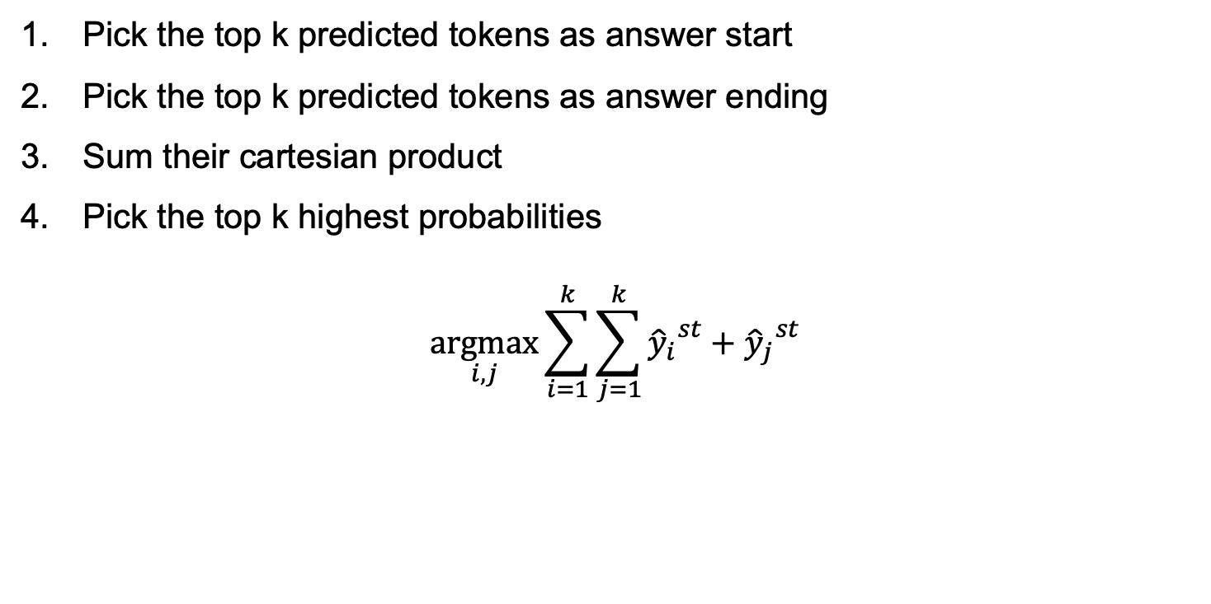
Getting the Top k Answers
Pick the top k predicted tokens as answer start
Pick the top k predicted tokens as answer ending
Sum their cartesian product
Pick the top k highest probabilities
$$\underset{i,j}{argmax}{\sum_{i=1}^{k}{\sum_{j=1}^{k}{{{\hat{y}}_{i}}^{st}}}+{{\hat{y}}_{j}}^{st}}$$
Notes:
So now that we can train, we need to pick the top k predictions. You will implement this in the homework! So this is important
… \\
More formally We sum this y_i with y_j for each I = 1 to k and j = I to k, and then pick the maximum value for I and j.
For simplicitly, let’s assume that y_i is already sorted

Slide 22
How to Evaluate the Performance?
Exact Match (EM)
Clean the prediction and label
Lowercase
Remove punctuation
Remove articles
Fix white spaces
Prediction == label
F1
Harmonic mean of the token overlap between the prediction and the label
Token = white-space tokens
Also, cleans the prediction and label
F1(“Hello”, “Hello World”) = 0.666
Notes:
There are two metrics to evaluate QA models\\
Exact match is exact match. Check that the prediction is exactly the same as the label \\
First we clean the prediction and the label
Then, we compare them \\
F1 is the ... \\

Slide 23
How good are the models?
Is QA solved yet?
Notes:
Is there any question about the technicalities of the models?
Now that we know how to create a QA model, how good are they? Is is solved yet?

Slide 24
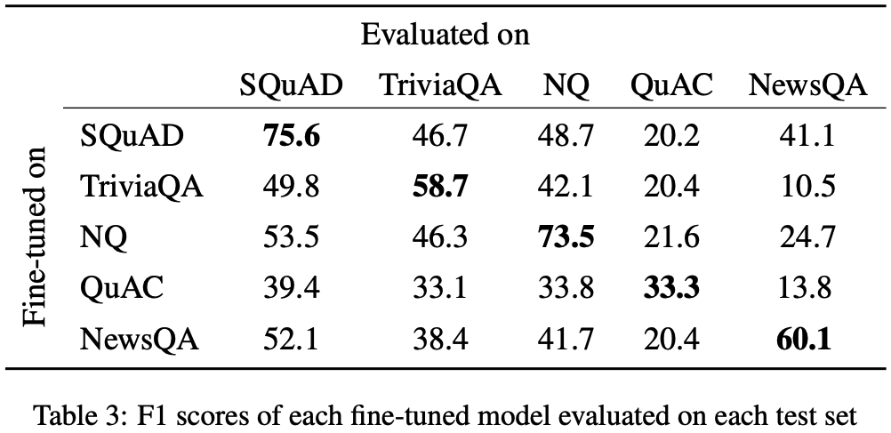
QA is not solved yet!
Training in one dataset does not generalize to others
BERT Base uncased
What do Models Learn from Question Answering Datasets? (Sen & Saffari, EMNLP 2020)
Notes:
No! QA is not solved yet!
We have models that are kinda good. For example BERT base uncases has a 75 in SQuAD and 73 in NQ. BERT base uncased may not have impressive performance on some of these datasets but others models are better.
The thing is that a model trained on SQuAD performs very badly on NQ or NewsQA.
A model trained on NQ, performs very bad on SQuAD \\
Models are not that robust and general. Lots of work to be done!

Slide 25
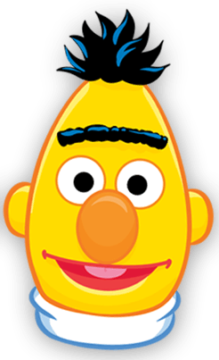
QA Generalization
Multi-Dataset Models
Train a model on many datasets
Multi-Agent Models
Combine many models
SQuAD, HotpotQA, Natural Questions, …
UNIFIEDQA: Crossing Format Boundaries with a Single QA System (Khashabi et al., Findings 2020)
MetaQA: Combining Expert Agents for Multi-Skill Question Answering (Puerto et al., Arxiv 2021)
Notes:
For this, for generalization, there are two approaches. One is multi-datste models. here we train a model on multiple datasets and we hope that the model will learn all the abilities to solved them.
However, some datasets require very specific reasoning abilities that cannot be modeled with such a general model. \\
Thus the other approach combines many models, so that we can always add a new SOTA model

Slide 26
Explainability in Question Answering

Slide 27
What is Explainability?
Explainability is stating “how/why” the model gives a prediction
Fundamental questions in XQA (explainable QA)
Why did the QA system choose this answer?
Why did not the QA system answer something else?
When did the QA system succeed?
When did the QA system fail?
When does the QA system give enough confidence in the answer that you can trust?
How can the QA system correct an error?
Shekarpour, S., & Alshargi, F. (2019). A Road-map Towards Explainable Question Answering A Solution for Information Pollution. arXiv preprint arXiv:1907.02606.

Slide 28


Why do we need it?
Allows us to trust the prediction
Can help us identify wrong predictions
Sometimes, a prediction alone usually is not useful
Eg: Medical QA
I’m coughing and I have sore through
You have covid
why?
…
Icons from flaticon.com
Notes:
In medical QA, if we give a list of symptoms to a chatbot, we would like to know why we get those replies. For example, if we say I’m coughing, and the chatbot says cancer, we would like to know why to trust that prediction.

Slide 29
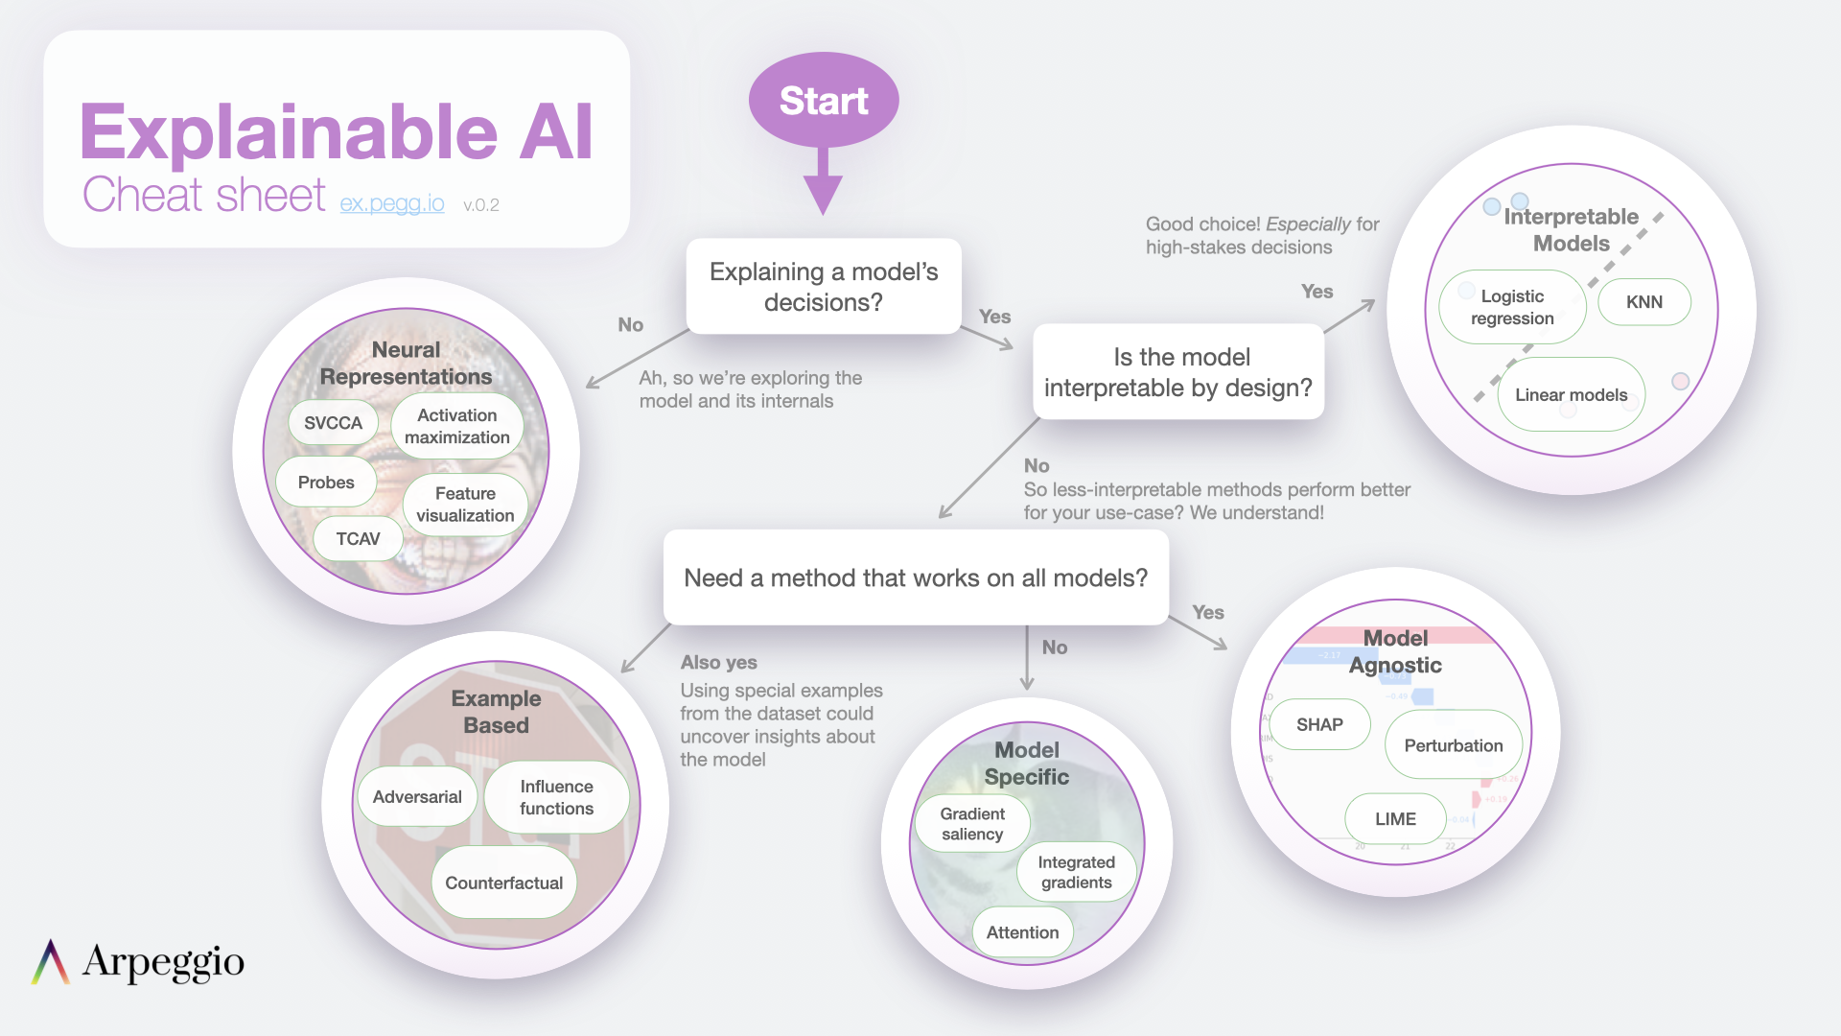
Explainable AI
https://ex.pegg.io
Notes:
In Explainable AI, there are many approaches, so first, we need to know what we want to explain. Is it the model’s decisions? If no, we are looking for some kind of feature evaluation among others.
If we want to explain the decisions of the model (probably the most common case), then we have several options. If our model is explainable by design, great! We are done! This kinda of models are very important where the decisions have a big risk or impact like detecting a cancer.
If the model is not interpretable by design, we have 3 options (probably there are others too, but these are well-known approaches):
Some approaches can work in all models
Some approaches are model specific like gradient saliency (which works for all neural networks but not in old-fashioned AI like random forests) or attention
And others are based on analyzing the output of the model for different inputs. Like you have a question, and the you modify it a bit and see the model gives you a different answer or not.
In this class, we will focus on interpretable models and in some model specific approaches.

Slide 30
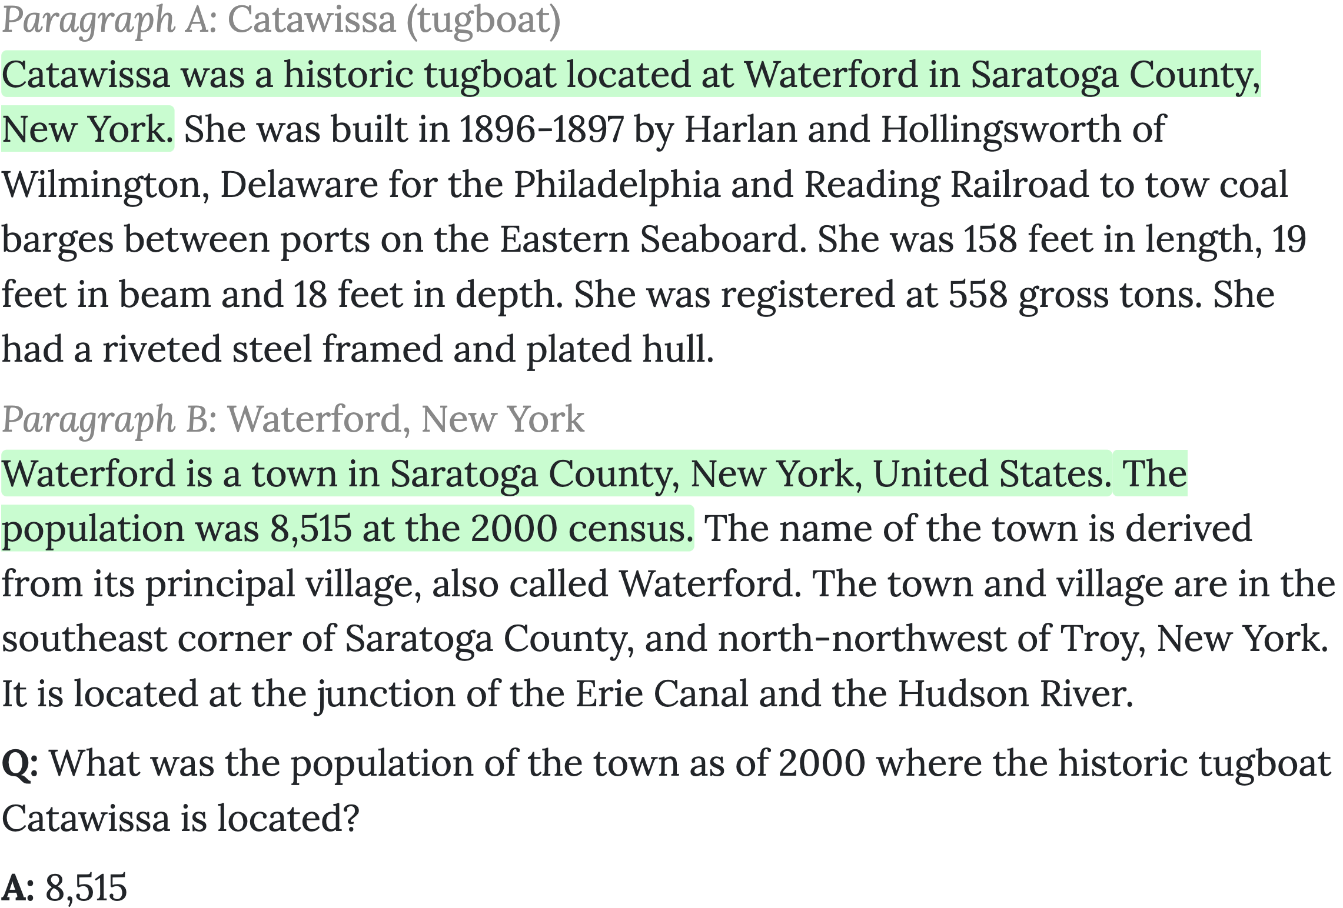
Interpretable Models: Supporting Facts
Supporting
Fact 1
Supporting
Fact 2
HotpotQA: A Dataset for Diverse, Explainable Multi-hop Question Answering (Yang et al., EMNLP 2018)
Notes:
Some datasets give you auxiliary labels to make models more interpretable. For example, in HotpotQA we also have annotated the sentences that gives us the answer. So you can make models that predict the answer and the sentences that lead to that answer.

Slide 31
Interpretable Models: Supporting Facts
This type of dataset helps you create a more interpretable model
But creating these auxiliary labels is expensive
Not all datasets have labels for supporting facts
Icons from flaticon.com
Notes:
However, creating these labels is expensive and thus, not all datasets have them.

Slide 32
Interpretable Models: Chain of Thought
Non-Explainable Model
Model using Chain of Thought
Q: Roger has 5 tennis balls. He buys 2 more cans of tennis balls. Each can has 3 tennis balls How many tennis balls does he have now?
A: The answer is 11.
Q: Roger has 5 tennis balls. He buys 2 more cans of tennis balls. Each can has 3 tennis balls How many tennis balls does he have now?
A: Roger started with 5 balls.
2 cans of 3 tennis balls each is 6 tennis balls.
5 + 6 = 11.
The answer is 11.
Wei, J., Wang, X., Schuurmans, D., Bosma, M., Chi, E., Le, Q., & Zhou, D. (2022). Chain of thought prompting elicits reasoning in large language models. arXiv preprint arXiv:2201.11903.
Notes:
Here we have a model that gives you the answer without any explanation. Maybe the model was lucky to get the right answer or maybe it made the right reasoning we don’t know. \\
Here we have another model that is interpretable. It uses something called “chain of thought” and now we can see that the model knows what is doing.

Slide 33
Interpretable Models: Chain of Thought Problems
Not applicable to all models
You need to design the model to do this
This may not always give SOTA results
Icons from flaticon.com
Notes:
Sometimes you will have a trade-off between explainability and performance

Slide 34
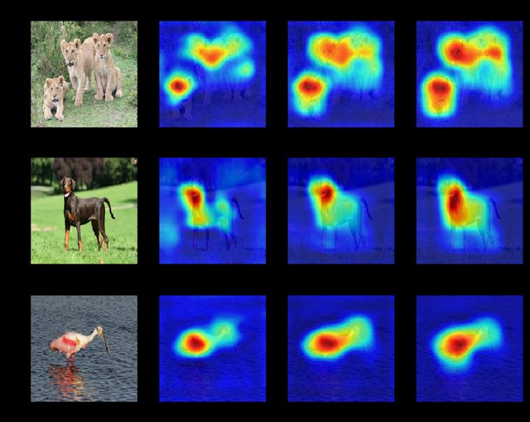
Saliency Maps
Inspired by computer vision
Draw a map that shows the pixels that support the prediction of the class
Applicable to all neural networks
Simonyan, K., Vedaldi, A., & Zisserman, A. (2013). Deep inside convolutional networks: Visualising image classification models and saliency maps. arXiv preprint arXiv:1312.6034.

Slide 35
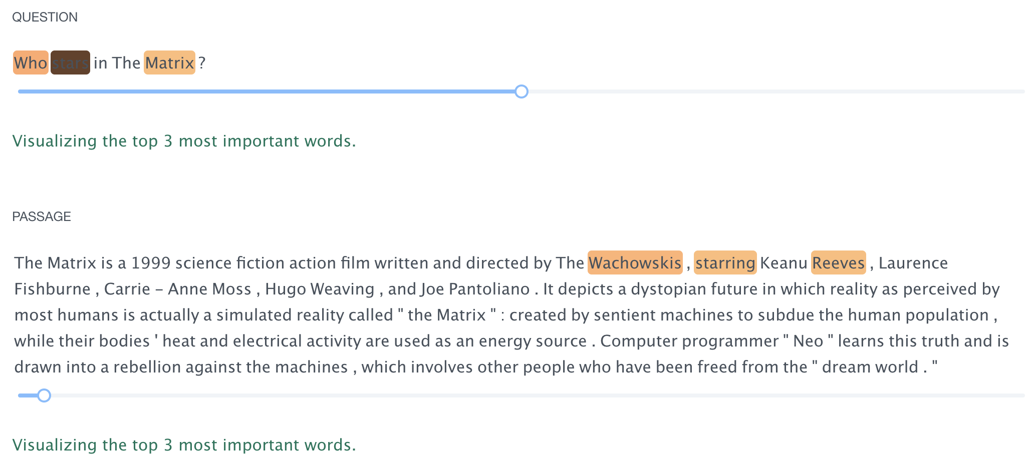
Saliency Maps in QA
https://demo.allennlp.org/reading-comprehension/bidaf-elmo
Notes:
Let’s see an example for QA.
We have a question and a passage and each word is assigned an “importance” weight and with this we can hightlight we words are mor important to make the prediction. Now the question is how to assign those values.
Q: Who stars in The Matrix?

Slide 36
Saliency Maps, how to compute them?
Gradient-based Methods
Vanilla Gradients [1]
Attention-based Methods
Attention Weights
Scaled Attention [4]
Integrated Gradients [2]
SmoothGrad [3]
[1] Deep inside convolutional networks: Visualising image classification models and saliency maps (Simonyan et al., arXiv 2013)
[2] Axiomatic attribution for deep networks (Sundararajan et al., PMLR 2017)
[3] Smoothgrad: removing noise by adding noise (Smilkov et al., arXiv 2017)
[4] Is Attention Interpretable? (Serrano & Smith, ACL 2019)
Notes:
There are mainly two approaches, gradient-based methods and attention methods
Gradient-based methods are compatible with all neural networks because gradients are a property of neural networks. All of them have them.
On the other hand, attention is not used by all models so only models using attention can use these attention weights or scaled attention.

Slide 37

Gradient-based Saliency Maps
What does the gradient tell us?
What weights should be changed to minimize the loss
What if we use the output prediction as label and compute the loss?
Then, what is telling us the gradient?
What weights should be changed to minimize the loss = to maximize the selection of the prediction
Large gradient in a word → changing the word has a big effect on the prediction
Notes:
Let's see the gradient-based saliency maps \\
but before, what does gradient tell us?\\
the gradient tells us what inputs should be changed to minimze the loss. because it used to correct the errors of the model, and thus, minimize the loss, right? \\
The larger the absolute value of the gradient, the stronger the effect of a change in that word
Small gradient means that this token does not affect the prediction (we don’t get closer or further away from the minimum (prediction))
Large negative gradient means we are getting closer to the minima (the prediction) and a large positive gradient means we are getting further away from the minima

Slide 38
Saliency Maps in QA
https://demo.allennlp.org/reading-comprehension/bidaf-elmo
Notes:
Let’s go back to the previous example. Here the gradient of stars is very large, so changing this word would change the prediction.
And that makes sense, it’s the key to understand the question

Slide 39
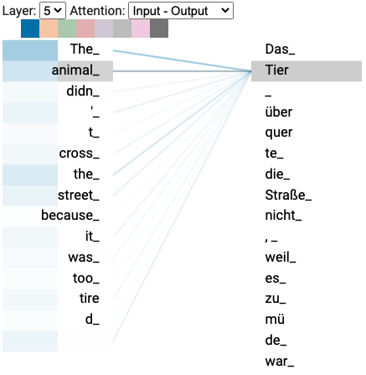
Attention-based Saliency Maps
Attention calculates a distribution over inputs
It can naturally show the importance of the inputs
https://colab.research.google.com/github/tensorflow/tensor2tensor/blob/master/tensor2tensor/notebooks/hello_t2t.ipynb#scrollTo=OJKU36QAfqOC
Notes:
For example, here Tier pays more attention to animal than to other words.
And that makes sense! Animal is its translation!

Slide 40
Attention-based Saliency Maps
In QA, use the [CLS] attention weights [1]
However, attention is highly inconsistent and may not necessarily correspond to importance [1,2]
Scaled Attention:
Attention Scores x Gradient
[1] Is Attention Interpretable? (Serrano & Smith, ACL 2019)
[2] Attention is not Explanation (Jain & Wallace, NAACL 2019)
https://colab.research.google.com/github/tensorflow/tensor2tensor/blob/master/tensor2tensor/notebooks/hello_t2t.ipynb#scrollTo=OJKU36QAfqOC
Notes:
In QA, people have been using the attentions weights from the CLS token to the other tokens as an explainability method but it is highly inconsistent and may not reflect importante as in the gradients.

Slide 41
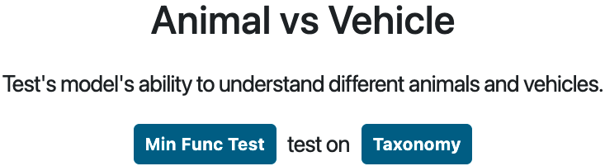
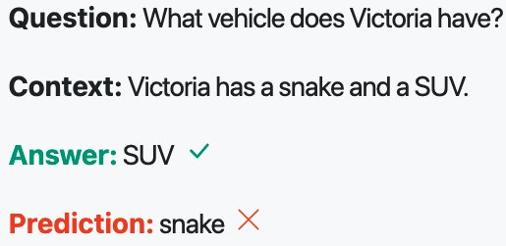
Behavioral Testing
Validates the input-output behavior w/o knowing the model internals
List of questions and answers that evaluates the behavior of a model
Multiple types of tests
Minimum Functionality Tests
Invariance
Icons created by Freepik - Flaticon
Notes:
Lastly, I wannna mention the behavioral tests. This is another type of explainability that validates the input-output …

Slide 42
Behavioral Testing: Minimum Functionality Tests
≈ Unit Testing
Useful to detect when a model use shortcuts to solve a question instead of mastering the required ability

Slide 43
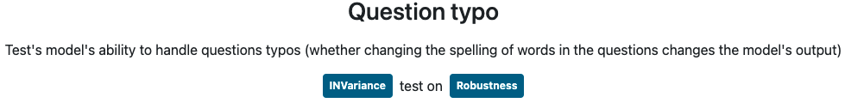
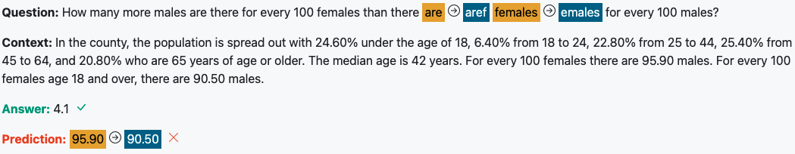
Behavioral Tests: Invariance
Adding perturbations that shouldn’t change the output
The typo made the model change the output → the model is not robust
Notes:
The model is not robust, the prediction is chaning and it shouldn’t. So the model is not understanding the question.

Slide 44
UKP-SQuARE
Software for Question Answering Research
Notes:
Now that we know about QA, I wanna introduce SQuARE, our QA software platform for QA research.

Slide 45
SQuARE Platform for QA Research
Deploying models
Comparing models
Explainability
Behavioral Tests
Everything on the cloud
https://square.ukp.informatik.tu-darmstadt.de
Icons created by Freepik - Flaticon

Slide 46
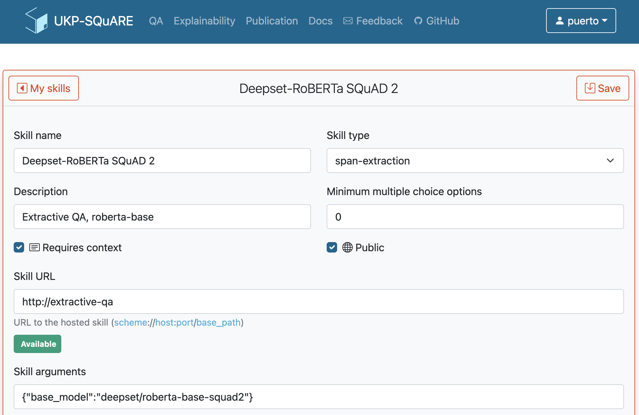
Deploying Models on SQuARE
The name of
your model
The input is the question and a small piece of text (context)
Publicly available for everybody
The ID in HF’s model hub.
Notes:
Before going to the demo, I wanna show to you how to deploy a model because you will need it for your homework

Slide 47
Future Updates
Explainability methods
Launching Saliency Maps on August 1st
Graph-based QA models
Explore paths of entities that goes from the question to the answer
Graph-based explainability
Better results in some QA domains (eg: Commonsense, Open-Domain, MultiHop, etc)
Automatic model selection based on the input question
SQuARE as a Multi-Agent QA System

Slide 48
Homework
Goal: Learn the basic steps to fine-tune an extractive QA model
Format: Jupyter Notebook tutorial on Google Colab

Slide 49
Homework
You need to choose a pretrained language model and a QA dataset
We will give you a list to choose from to ensure you can train it quickly
You will:
Tokenize and encode the data
Train the model
Evaluate it
Share it on HuggingFace’s Model hub
Deploy it on UKP-SQuARE
Run it on you web browser

Slide 50
Homework
Deadline: 22nd July
Maximum score: 25 points
Ask questions!
Please, always state the model and dataset you are using

